Slide 1
Thermal Engineering II
Power Plant Economics
Dr. P.V. Manu
Assistant Professor
Dept. of Mechanical Engineering
National Institute of Technology Calicut

Slide 2
Power Plant Economics
Power plant engineering economics of power system, use certain well established techniques for choosing the most suitable system.
The power plant design must be made on the basis of most economical condition and not on the most efficient condition as the profit is the main basis in the design of the plant and its effectiveness is measured financially.
The main purpose of design and operation of the plant is to bring the cost of energy produced to minimum.
Among many factors, the efficiency of the plant is one of the factors that determines the energy cost. In majority of cases, unfortunately, the most thermally efficient plant is not economic one.

Slide 3
Terms and Definitions
Connected load – The connected load on any system or part of a system, is the combined continuous rating of all the receiving apparatus on consumer's premises, which is connected to the system or part of the system, under consideration.
Demand – The demand of an installation or system is the load that is drawn from the source of supply at the receiving terminals averaged over a suitable and specified interval of time. It is expressed in kW, kVA, A or other suitable units.

Slide 4
Power Plant Economics
Maximum demand or Peak load – The maximum demand of an installation or system is the greatest of all the demands that have occurred during a given period. It is determined by measurement, according to specifications, over a prescribed interval of time.
Demand factor – The demand factor of any system or part of a system, is the ratio of maximum demand of the system, a part of the system, to the total connected load of the system or of the part of the system, under consideration. Expressing mathematically,
Demand factor = Maximum demand / Connected load

Slide 5
Power Plant Economics
Load factor – it is the ratio of the average power to the maximum demand. In each case, the interval of maximum load and the period over which the average is taken should be definitely specified. The proper interval and period are usually dependent upon local conditions and upon the purpose for which the load factor is to be used.
mathematically,
Load factor = Average load / Maximum demand
Utilization factor – defined as the ratio of the maximum generator demand to the generator capacity.

Slide 6
Power Plant Economics
Diversity factor – of any system or part of a system, is the ratio of the maximum power demands of the subdivisions of the system or part of a system to the maximum demand of the whole system or part of the system, under consideration, measured at the point of supply.
Expressing mathematically,
Diversity factor = Sum of individual max. demands /
Max. demand of entire group

Slide 7
Power Plant Economics
Plant capacity factor – it is defined as the ratio of actual energy produced in kWh to the maximum possible energy that could have been produced during the same period.
Mathematically,
Plant capacity factor = E / (C x t)
E = Energy produced (kWh) in a given period
C = Capacity of the plant in kW
t = Total number of hours in the given period

Slide 8
Power Plant Economics
Plant use factor – it is defined as the ratio of energy produced in a given time to the maximum possible energy that could have been produced during the actual number of hours the plant was in operation.
Mathematically,
Plant use factor = E / (C x t’)
E = Energy produced (kWh) in a given period
C = Capacity of the plant in kW
t’ = Actual number of hours the plant has been in operation

Slide 9
Power Plant Economics
Types of loads
(i.) Residential load – includes domestic lights, power needed for domestic appliances
(ii.) Commercial load – includes lighting for shops, advertisements and electrical appliances used in shops and restaurants etc.
(iii.) Industrial load – consists of load demand of various industries
(iv.) Municipal load – consists of street lighting, power required for water supply and drainage purposes
(v.) Irrigation load – includes electrical power needed for agriculture (pumps driven by motors to supply water)
(vi.) Traction load – includes trams, cars, trolley, buses and railways

Slide 10
Power Plant Economics
Load curve – load curve or load graph, is a graphical record showing the power demands for every instant during a certain time interval. Such a record may cover 1 hour, in which case it would be an hourly load graph; 24 hours, in which case it would be a daily load graph; a month in which case it would be a monthly load graph; or a year (8760 hours), in which case it would be a yearly load graph.

Slide 11
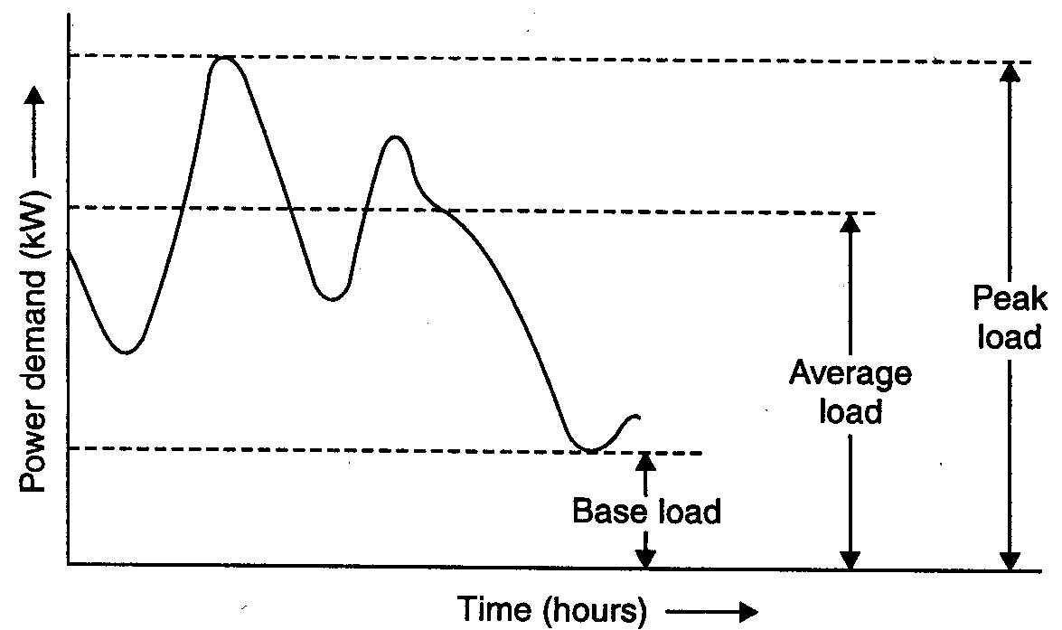
Power Plant Economics
Load curve

Slide 12
Power Plant Economics
Load curve
(i.) Area under the load curve represents the energy generated in the period considered.
(ii.) Area under the curve divided by the total number of hours gives the average load on the power station.
(iii.) Peak load indicated buy the load curve/graph represents the maximum demand of the power station.

Slide 13
Power Plant Economics
Significance of load curves
(i.) It gives full information about the incoming load and help to decide the installed capacity of the power station and to decide the economical sizes of various generating units.
(ii.) Helps to estimate the generating cost and to decide the operating schedule of the power station (i.e, the sequence in which different units should be run.)

Slide 14
Power Plant Economics
Load duration curve – load duration curve represents re-arrangements of all the load elements of chronological load curve in order of descending magnitude. This curve is derived from the chronological load curve.
Figure shows a typical daily load curve for a power station. It may be observed that the maximum load on power station is 35 kW from 8 AM to 2 PM. This is plotted in next figure, similarly other loads of the load curve are plotted in descending order in the same figure. This is called load duration curve.

Slide 15
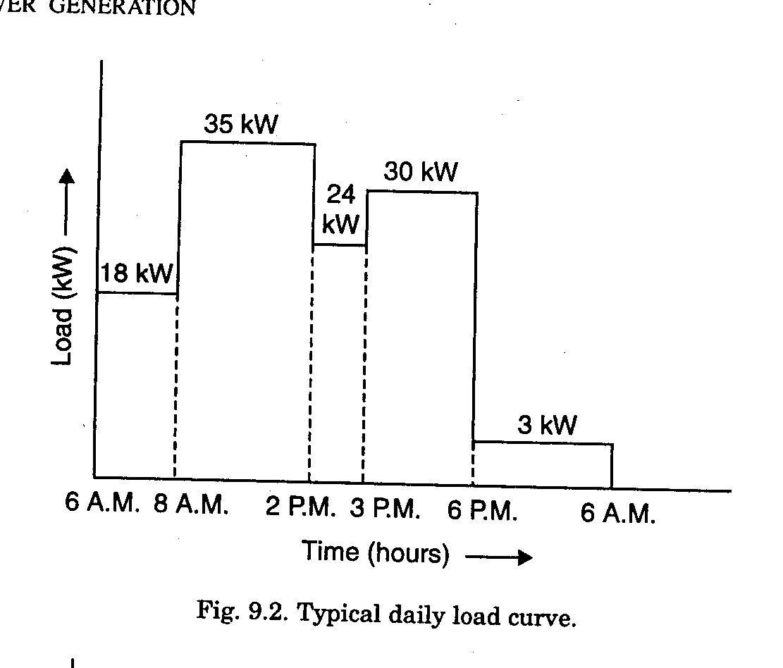
Power Plant Economics
Typical daily load curve

Slide 16
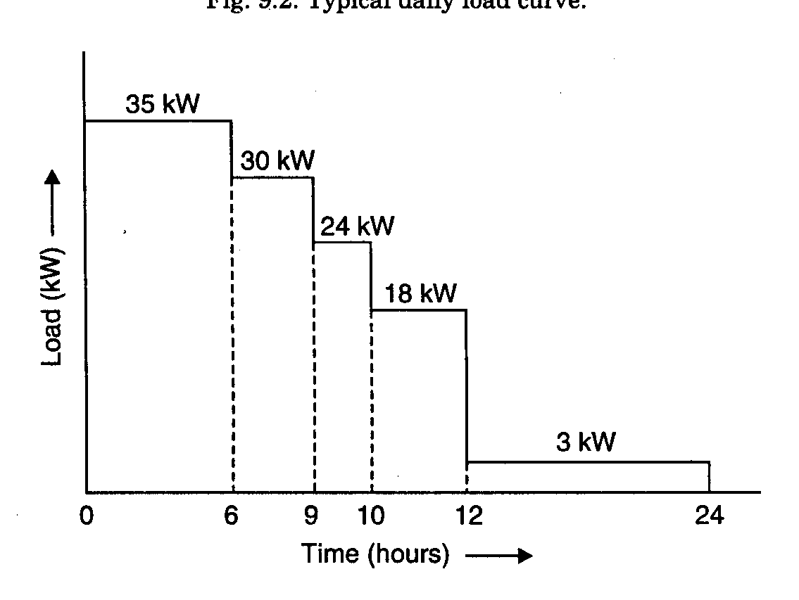
Power Plant Economics
Load duration curve

Slide 17
Power Plant Economics
Load duration curve
(i.) Area under the load duration curve and the corresponding chronological load curve is equal and represents total energy delivered by the generating station.
(ii.) It gives a clear analysis of generating power economically. Proper selection of base load power plants and peak load power plants becomes easier.

Slide 18
Power Plant Economics
Dump power – this term is used in hydroplants and it shows the power in excess of the load requirements and it is made available by surplus water.
Firm power – it is the power which should always be available even under emergency conditions.
Prime power – it is the power which may be mechanical, hydraulic or thermal that is always available for conversion into electric power.

Slide 19
Power Plant Economics
Cold reserve – it is that reserve generating capacity which is not in operation but can be made available for service.
Hot reserve – it is that reserve generating capacity which is in operation but not in service.
Spinning reserve – it is that reserve generating capacity which is connected to the bus (bar/strip in electric power distribution) and is ready to take the load.

Slide 20
Principles of Power Plant Design
Factors that should be considered while designing a power plant:
(i.) Simplicity of design
(ii.) Low capital cost
(iii.) Low cost of energy generated
(iv.) High efficiency
(v.) Low maintenance cost
(vi.) Low operating cost
(vii.) Reliability of supplying power
(viii.) Reserve capacity to meet future power demand

Slide 21
Cost Analysis
The cost of a power system depends upon whether:
(i.) an entirely new power system has to be set up, or
(ii.) an existing system has to be replaced, or
(iii.) an extension has to be provided to the existing system.

Slide 22
Cost Analysis
The various costs involved are:
(1.) Capital cost or Fixed cost, which includes
(i.) Initial cost (ii.) Interest
(iii.) Depreciation cost (iv.) Taxes
(v.) Insurance
(2.) Operational cost, which includes
(i.) Fuel cost (ii.) Operating labour cost
(iii.) Maintenance cost (iv.) Supplies
(v.) Supervision (vi.) Operating taxes

Slide 23
Cost Analysis
Initial cost
Some of the several factors on which cost of a generating station or a power plant depends are:
(i.) Location of the plant
(ii.) Time of construction
(iii.) Size of units
(iv.) Number of main generating units
(v.) Type of structure to be used

Slide 24
Cost Analysis
Initial cost
The initial cost of a power station includes the following:
(i.) Land cost
(ii.) Building cost
(iii.) Equipment cost
(iv.) Installation cost
(v.) Over head charges, which will include the transportation cost, stores and store keeping charges, interest during construction, etc.

Slide 25
Cost Analysis
Initial cost
To reduce the cost of building, it is desirable to eliminate the superstructure over the boiler house and as far possible on turbine house also.
Also by simplifying the piping system and elimination of duplicate system such as steam headers and boiler feed headers. The cost can be further reduced by eliminating duplicate or stand-by auxiliaries.
When the power plant is not situated in the proximity to the load served, the cost of a primary distribution system will be a part of the initial investment.

Slide 26
Cost Analysis
Interest
All enterprises need investment of money and this money may be obtained as loan, through bonds and shares or from owners of personal funds.
Interest is the difference between money borrowed and money returned.
It may be charged at a simple rate expressed as % per annum or may be compounded, in which case the interest is reinvested and adds to the principal, thereby earning more interest in subsequent years.
Even if the owner invests his own capital the charge of interest is necessary to cover the income that he would have derived from it through an alternative investment or fixed deposit with a bank.

Slide 27
Cost Analysis
Depreciation
Depreciation accounts for the deterioration of the equipment and decrease in its value due to corrosion, weathering and wear and tear with use.
It also covers the decrease in value of equipment due to obsolescence.
With rapid improvements in design and construction of plants, obsolescence factor is of enormous importance.
Availability of better models with lesser overall cost of generation makes it imperative to replace the old equipment earlier than its useful life is spent.

Slide 28
Cost Analysis
Depreciation
The actual life span of the plant has, therefore, to be taken as shorter than what would be normally expected out of it.
The following methods are used to calculate the depreciation cost:
(i.) Straight line method
(ii.) Percentage method
(iii.) Sinking fund method
(iv.) Unit method

Slide 29
Depreciation
Straight line method
The life of the equipment or the enterprise is first assessed and also the residual or salvage value of the same after the estimated life span.
This salvage value is deduced from the initial capital cost and the balance is divided by the life as assessed in years.
Thus, the annual value of decrease in cost of the equipment is found and set aside as depreciation annually from the income.
Hence the rate of depreciation is uniform throughout the life of the equipment.

Slide 30
Depreciation
Straight line method
By the time equipment has lived out its useful life , an amount equivalent to its net cost is accumulated which can be utilized for replacement of the plant.

Slide 31
Depreciation
Sinking fund method
Method is based on the concept that the annual uniform deduction from income for depreciation will accumulate to the capital value of the plant at the end of life of the plant or equipment.
In this method , the amount set aside per year consists of annual instalments and the interest earned on all the instalments.

Slide 32
Depreciation
Sinking fund method
If, A = amount set aside at the end of each year for ‘n’ years
n = life of plant in years
S = salvage value at the end of plant life
I = annual rate of compound interest on the invested capital
P = initial investment to install the plant
then
P – S = [((1 + i)^{n} – 1) / i] . A

Slide 33
Cost Analysis
Operational cost
The elements that make up the operating expenditure of a power plant include the following costs:
(i.) Cost of fuels
(ii.) Labor cost
(iii.) Cost of maintenance and repairs
(iv.) Cost of stores (other than fuel)
(v.) Supervision
(vi.) Taxes

Slide 34
Factors Affecting Economics of Generation and Power Distribution
The economics of power plant operation is greatly
influenced by
(i.) Load factor
(ii.) Demand factor
(iii.) Utilisation factor

Slide 35
Reduction in Power Generation Cost
The cost of power generation can be reduced by:
(i.) Using a plant of simple design that does not need highly skilled personnel.
(ii.) Selecting equipment of longer life and proper capacities.
(iii.) Carrying out proper maintenance of power plant equipment to avoid plant break downs.
(iv.) Running the power stations at high load factors.
(v.) Increasing the efficiency of the power plant.
(vi.) Keeping proper supervision, which ensures less breakdowns and extended plant life.

